Slide 1
jQuery AJAX calls
Selva kumar S
Assistant Professor, Department of CS&E
selva.cse@bmsce.ac.in

Slide 2
Demo URL
http://www.jqueryrain.com/?HLGUHXRP
http://bylancer.com/product/spider/demo/mailgun.html
http://bylancer.com/product/spider/demo/selector.html
http://bylancer.com/product/spider/demo/tab.html
http://www.jqueryrain.com/?cQa2VztP
http://www.jqueryrain.com/?IdrzpYda
http://fancygrid.com/dashboards/iots/
http://helloform.net/helloform/admin.php?page=dashboard

Slide 3
AJAX
AJAX is an acronym standing for Asynchronous JavaScript and XML and this technology helps us to load data from the server without a browser page refresh.
JQuery is a great tool which provides a rich set of AJAX methods to develop next generation web application.

Slide 4
Loading Simple Data
JQuery provides load() method to load any static and dynamic data using JQuery AJAX.
[selector].load( URL, [data], [callback] );
Parameters:
URL: The URL of the server-side resource to which the request is sent. It could be a CGI, ASP, JSP, or PHP script which generates data dynamically or out of a database.
data: This optional parameter represents an object whose properties are serialized into properly encoded parameters to be passed to the request. If specified, the request is made using the POST method. If omitted, the GET method is used.
callback: A callback function invoked after the response data has been loaded into the elements of the matched set. The first parameter passed to this function is the response text received from the server and second parameter is the status code.

Slide 5
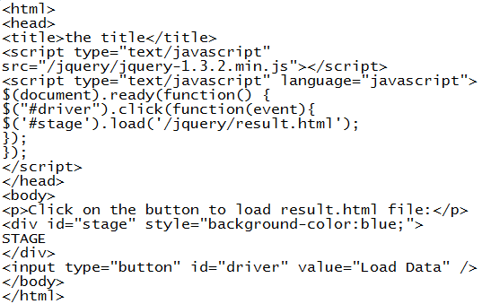
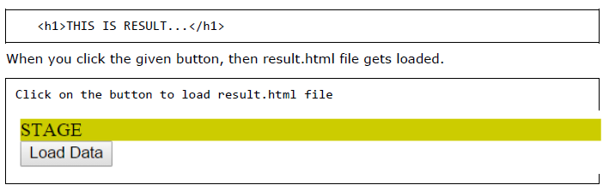
Example

Slide 6
Getting JSON Data
JQuery utility function getJSON() parses the returned JSON string and makes the resulting string available to the callback function as first parameter to take further action.
[selector].getJSON( URL, [data], [callback] );
Parameters:
URL: The URL of the server-side resource contacted via the GET method.
Data: An object whose properties serve as the name/value pairs used to construct a query string to be appended to the URL, or a preformatted and encoded query string.
Callback: A function invoked when the request completes. The data value resulting from digesting the response body as a JSON string is passed as the first parameter to this callback, and the status as the second.

Slide 7
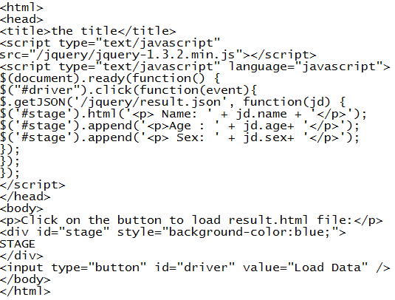
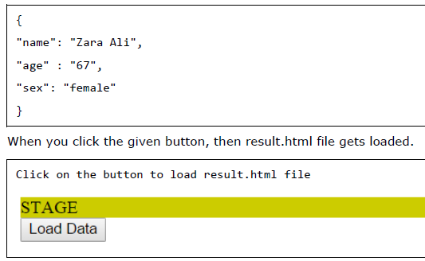
Example

Slide 8
Passing Data to the Server
Many times you collect input from the user and you pass that input to the server for further processing.
JQuery AJAX made it easy enough to pass collected data to the server using data parameter of any available Ajax method.

Slide 9
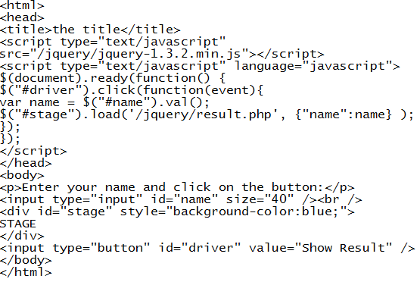
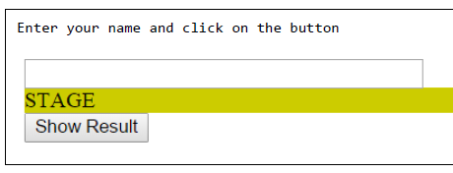
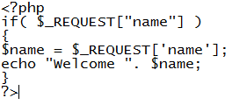
Example

Slide 10
JQuery AJAX Methods
jQuery.ajax( options )
Load a remote page using an HTTP request.
jQuery.ajaxSetup( options )
Setup global settings for AJAX requests.
jQuery.get( url, [data], [callback], [type] )
Load a remote page using an HTTP GET request.
jQuery.getJSON( url, [data], [callback] )
Load JSON data using an HTTP GET request.
jQuery.getScript( url, [callback] )
Loads and executes a JavaScript file using an HTTP GET request.

Slide 11
jQuery.post( url, [data], [callback], [type] )
Load a remote page using an HTTP POST request.
load( url, [data], [callback] )
Load HTML from a remote file and inject it into the DOM.
serialize( )
Serializes a set of input elements into a string of data.
serializeArray( )
Serializes all forms and form elements like the .serialize() method but returns a JSON data structure for you to work with.

Slide 12
jQuery.ajax( options ) Method
The jQuery.ajax( options ) method loads a remote page using an HTTP request. $.ajax() returns the XMLHttpRequest that it creates.
$.ajax( options )
Parameters:
options: A set of key/value pairs that configure the Ajax request. All options are optional.

Slide 13
Here is the list of option which could be used as key/value pairs. Except URL, rest of the parameters are optional:
async
A Boolean indicating whether to perform the request asynchronously. The default value is true.
beforeSend
A callback function that is executed before the request is sent.
complete
A callback function that executes whenever the request finishes.
contentType
A string containing a MIME content type to set for the request. The default value is application/x-www-form-urlencoded.
data
A map or string that is sent to the server with the request.
dataFilter
A function to be used to handle the raw responsed data of XMLHttpRequest. This is a pre-filtering function to sanitize the response.

Slide 14
dataType
A string defining the type of data expected back from the server (xml, html, json, or script).
error
A callback function that is executed if the request fails.
Global
A Boolean indicating whether global AJAX event handlers will be triggered by this request. The default value is true.
ifModified
A Boolean indicating whether the server should check if the page is modified before responding to the request.
Jsonp
Override the callback function name in a jsonp request.
Password
A password to be used in response to an HTTP access authentication request.
processData
A Boolean indicating whether to convert the submitted data from an object form into a query-string form. The default value is true.
success
A callback function that is executed if the request succeeds.

Slide 15
Timeout
Number of milliseconds after which the request will time out in failure.
timeout
Set a local timeout (in milliseconds) for the request.
type
A string defining the HTTP method to use for the request (GET or POST). The default value is GET.
url
A string containing the URL to which the request is sent.
username
A username to be used in response to an HTTP access authentication request.
xhr
Callback for creating the XMLHttpRequest object. Defaults to the ActiveXObject
when available (IE), the XMLHttpRequest otherwise.

Slide 16
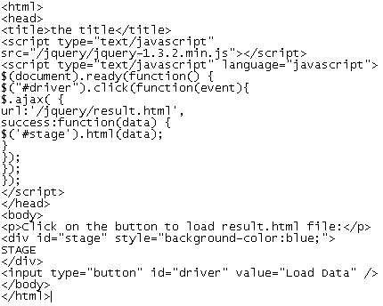

Example

Slide 17
ajaxSetup( options ) Method
The jQuery.ajaxSetup( options ) method sets global settings for future AJAX requests.
$.ajaxSetup( options )
Parameters:
options: A set of key/value pairs that configure the Ajax request. All options are optional.

Slide 18
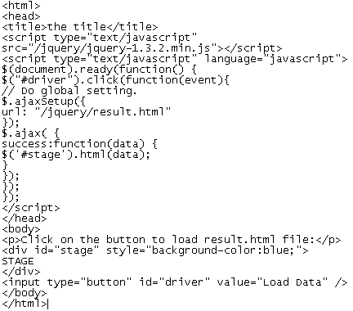
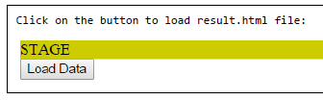
Example

Slide 19
get( url, [data], [callback], [type] ) Method
The jQuery.get( url, [data], [callback], [type] ) method loads data from the server using a GET HTTP request. The method returns XMLHttpRequest object.
$.get( url, [data], [callback], [type] )
parameters used by this method:
url: A string containing the URL to which the request is sent
data: This optional parameter represents key/value pairs that will be sent to the server.
callback: This optional parameter represents a function to be executed whenever the data is loaded successfully.
type: This optional parameter represents type of data to be returned to callback function: "xml", "html", "script", "json", "jsonp", or "text".

Slide 20
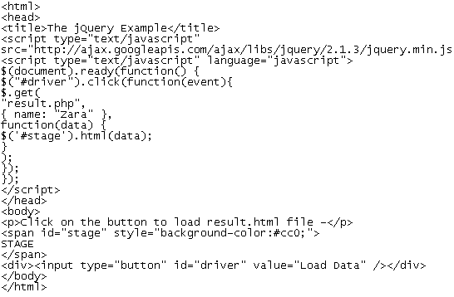

Example

Slide 21
getScript( url, [callback] ) Method
The jQuery.getScript( url, [callback] ) method loads and executes a JavaScript file using an HTTP GET request. The method returns XMLHttpRequest object.
$.getScript( url, [callback] )
parameters used by this method:
url: A string containing the URL to which the request is sent
callback:: This optional parameter represents a function to be executed whenever the data is loaded successfully.

Slide 22
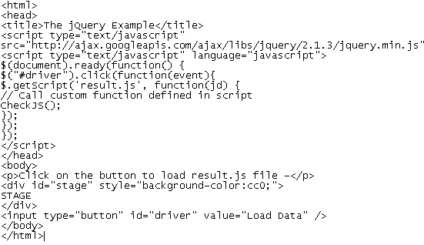
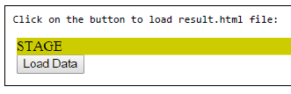
Example

Slide 23
post( url, data, callback, type ) Method
The jQuery.post( url, [data], [callback], [type] ) method loads a page from the server using a POST HTTP request. The method returns XMLHttpRequest object.
$.post( url, [data], [callback], [type] )
the parameters used by this method:
url: A string containing the URL to which the request is sent
Data: This optional parameter represents key/value pairs or the return value of the .serialize() function that will be sent to the server.
Callback: This optional parameter represents a function to be executed whenever the data is loaded successfully.
Type: This optional parameter represents a type of data to be returned to callback function: "xml", "html", "script", "json", "jsonp", or "text".

Slide 24
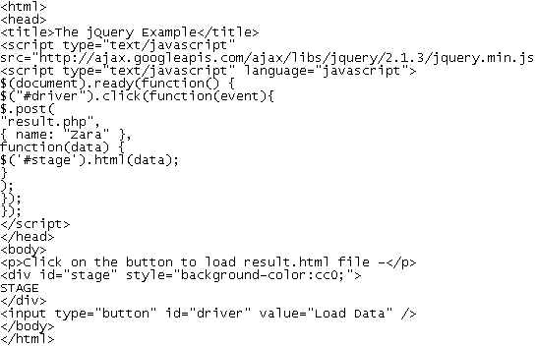
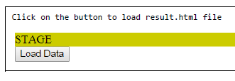
Example

Slide 25
load( url, data, callback ) Method
The load( url, data, callback ) method loads data from the server and places the returned HTML into the matched element.
[selector].load( url, [data], [callback] )
The parameters used by this method:
url: A string containing the URL to which the request is sent.
data: This optional parameter represents a map of data that is sent with the request.
callback: This optional parameter represents a function that is executed if the request succeeds

Slide 26
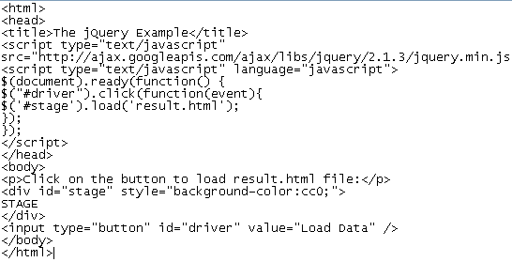
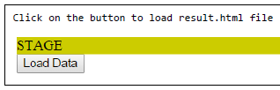
Example

Slide 27
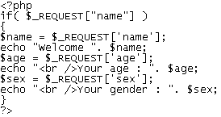
serialize( ) Method
The serialize( ) method serializes a set of input elements into a string of data.
$.serialize( )
/jquery/Serialize.php

Slide 28
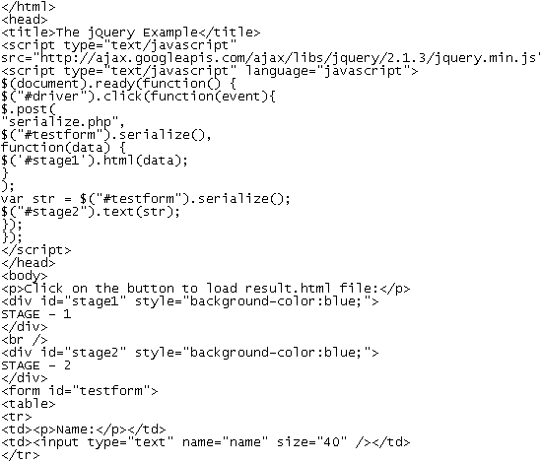
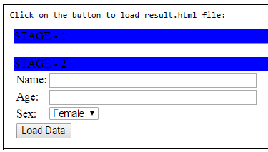
Example

Slide 29
serializeArray( ) Method
The serializeArray( ) method serializes all forms and form elements like the .serialize() method but returns a JSON data structure for you to work with. The JSON structure returned is not a string. You must use a plugin or third-party library to "stringify".
$.serializeArray( )

Slide 30
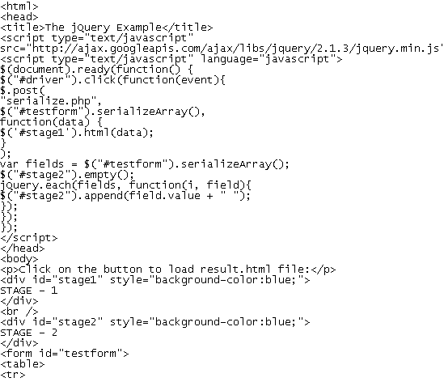
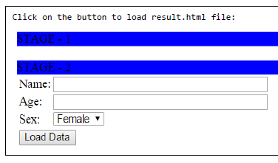
Example

Slide 31
JQuery AJAX Events
You can call various JQuery methods during the life cycle of AJAX call progress. Based on different events/stages, the following methods are available.
ajaxComplete( callback )
Attach a function to be executed whenever an AJAX request completes.
ajaxStart( callback )
Attach a function to be executed whenever an AJAX request begins and there is none already active.
ajaxError( callback )
Attach a function to be executed whenever an AJAX request fails.
ajaxSend( callback )
Attach a function to be executed before an AJAX request is sent.
ajaxStop( callback )
Attach a function to be executed whenever all AJAX requests have ended.
ajaxSuccess( callback )
Attach a function to be executed whenever an AJAX request completes successfully.

Slide 32
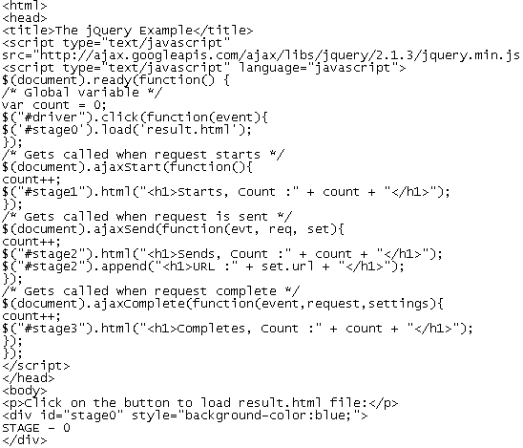
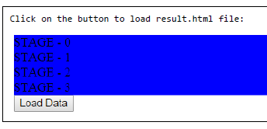
Example

Slide 33
Assignment
Use the above discussed jQuery AJAX metods to access profile details from student.html and display it on screen.

Slide 34
Further Study
www.tutorialpoint.com
www.tutorialrepublic.com

